Slide 1
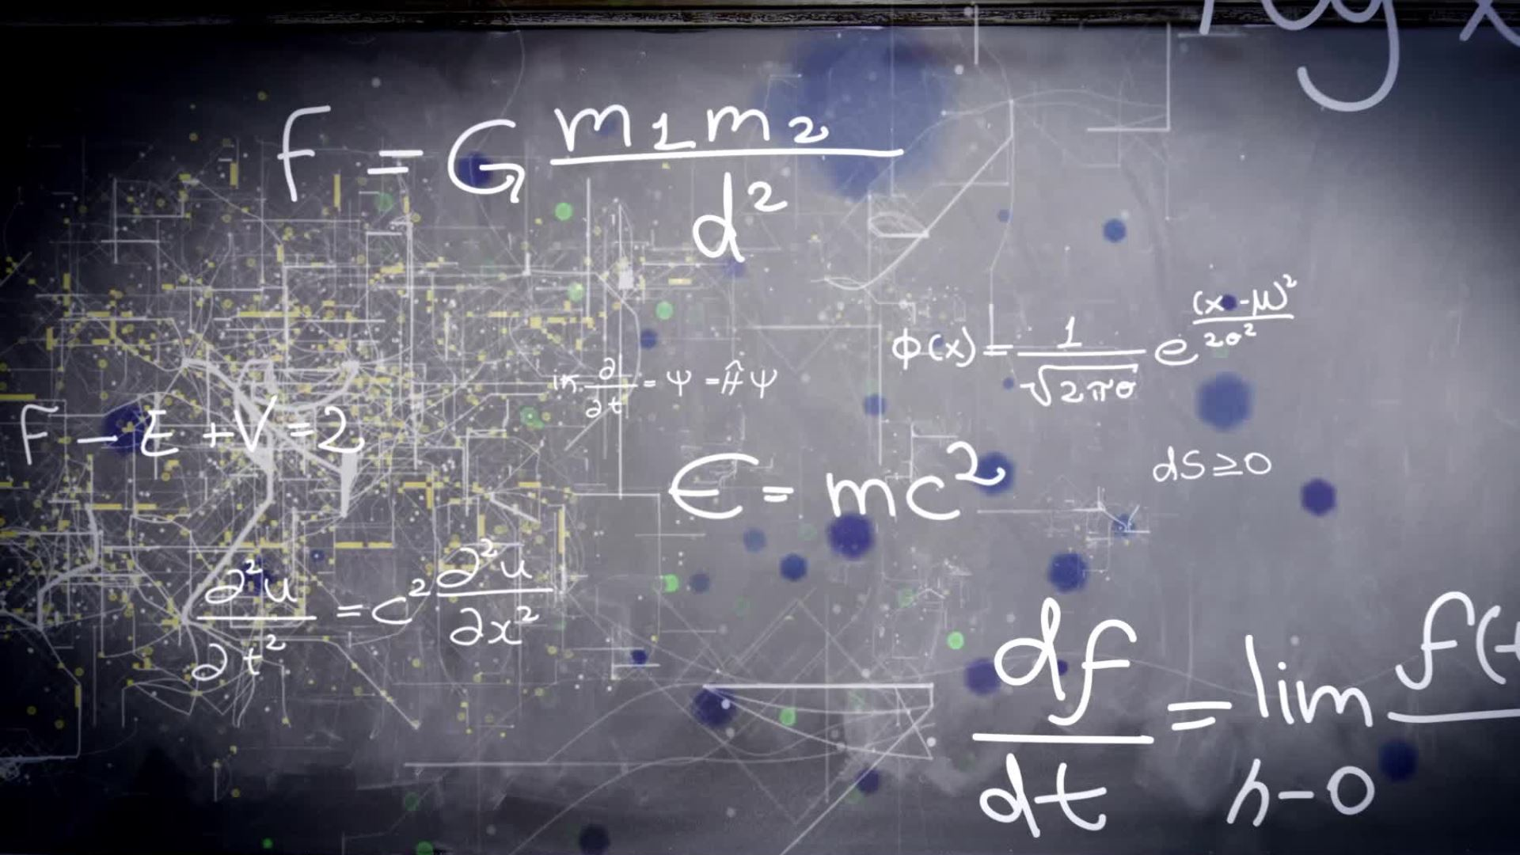
Machine Learning
By Aishwarya M.

Slide 2

Content
What is Machine Learning ?
History of ML
Real-time Application
Skills needed for ML
Why Python for machine learning
How does Machine Learning work ?
Types of ML
Machine learning algorithm

Slide 3
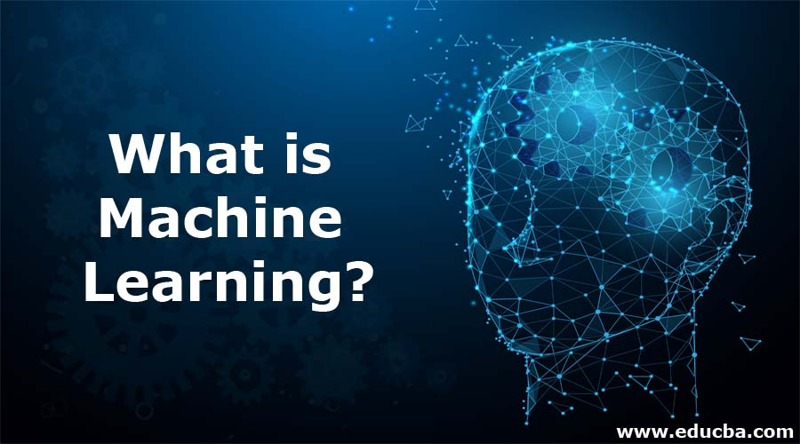

Slide 4
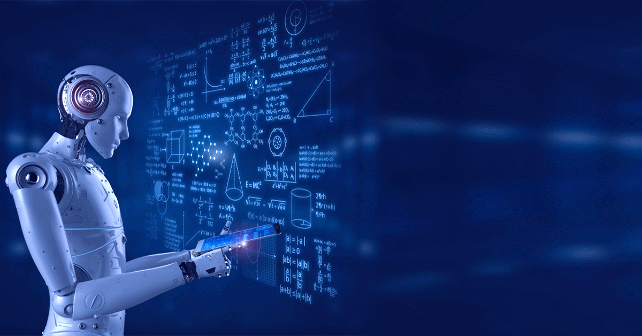

Slide 5
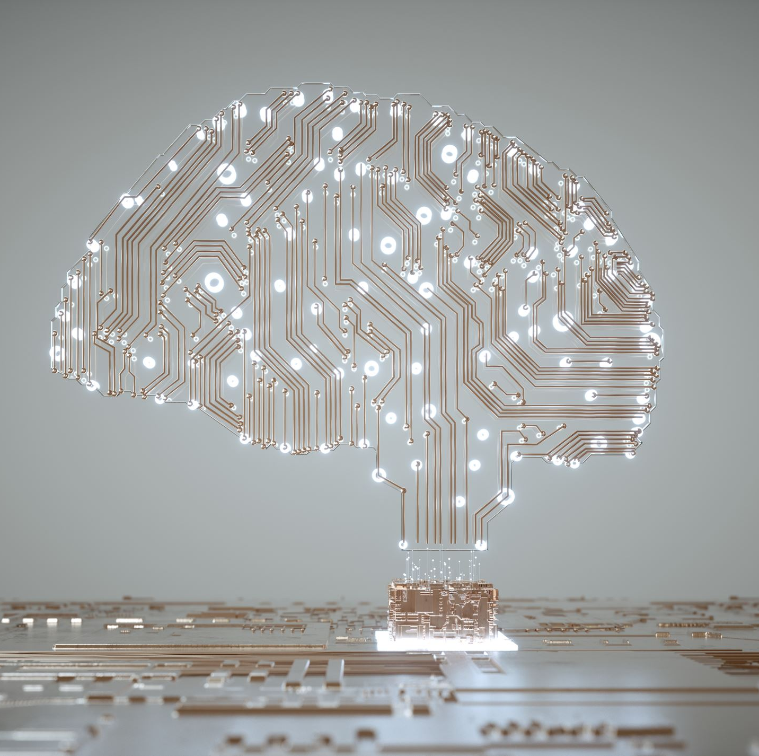
What is ML ?
Machine learning is a branch of artificial intelligence (AI) and computer science which focuses on the use of data and algorithms to imitate the way that humans learn, gradually improving its accuracy.

Slide 6

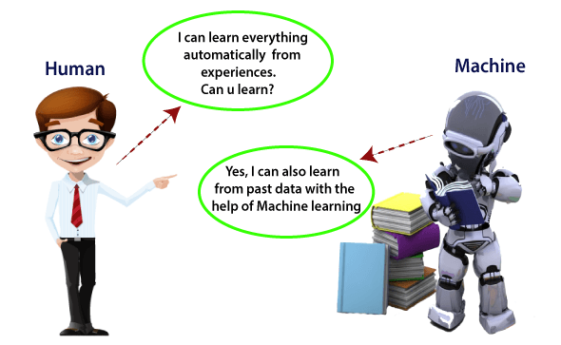

Slide 7
Machine Learning is the field of study that gives computers the capability to learn without being explicitly programmed. ML is one of the most exciting technologies that one would have ever come across.
Machine learning is a growing technology which enables computers to learn automatically from past data. Machine learning uses various algorithms for building mathematical models and making predictions using historical data or information.
Currently, it is being used for various tasks such as image recognition, speech recognition, email filtering, Facebook auto-tagging, recommender system, and many more.

Slide 8
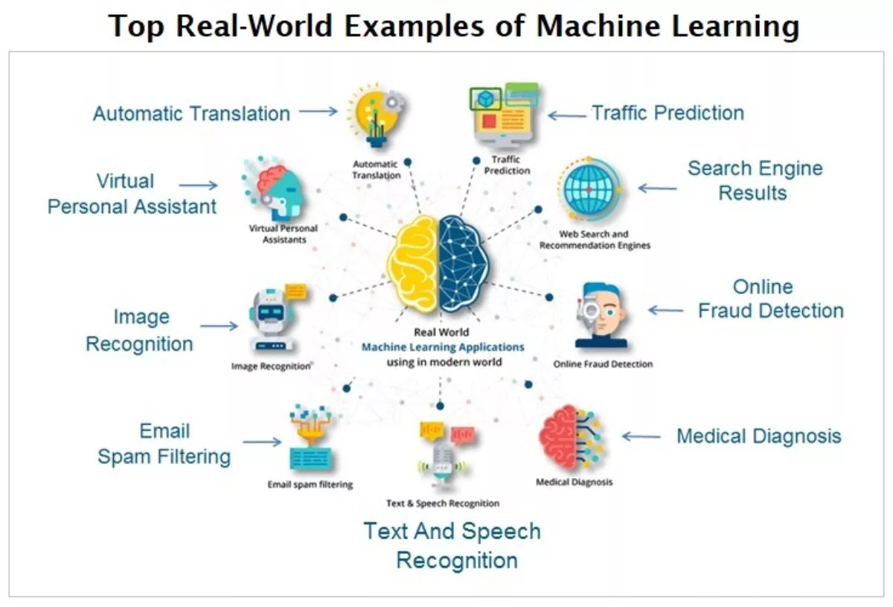
Real-Life examples of ML

Slide 9
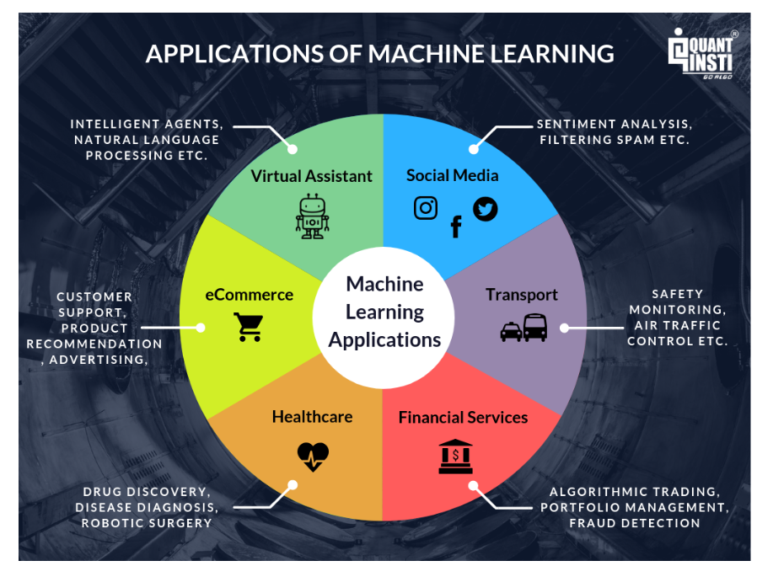

Slide 10
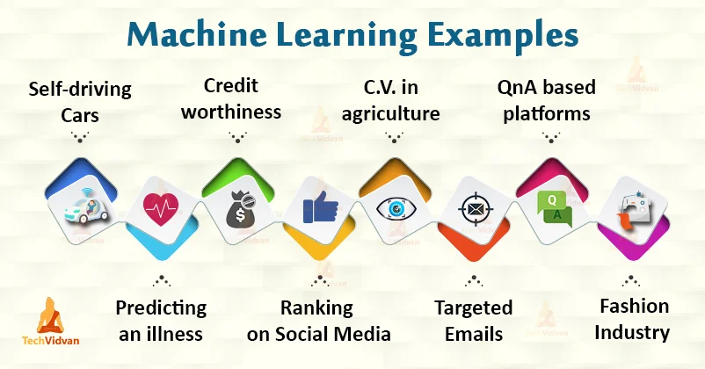

Slide 11
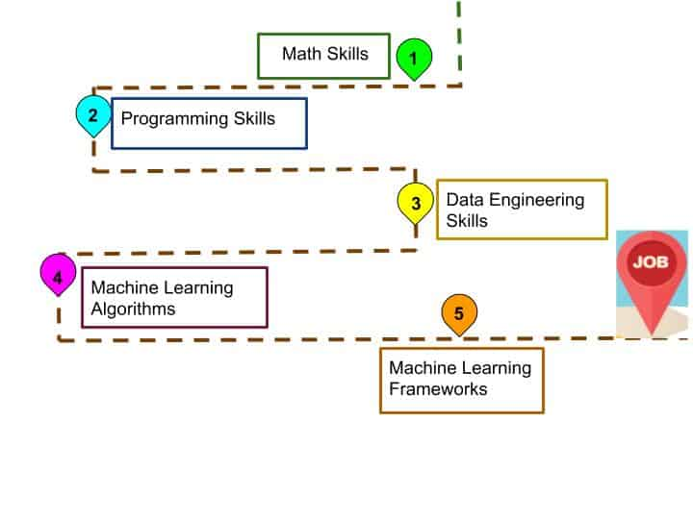
Skills needed for ML

Slide 12
Why Python is necessary for ML ?
Simple and consistent
Extensive selection of libraries and frameworks
Platform independence
Great community
Visualization tools
Readability
Versions: Python 2.x series and Python 3.x series, Latest version Python 3.10.2

Slide 13

How does Machine Learning work ?

Slide 14
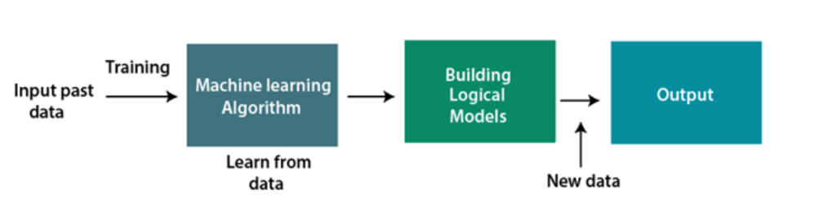
A Machine learning system learns from historical data, builds the prediction model, and whatever it receives new data, predicts the output for it.
The accuracy of predicted output depends upon the amount of data, as the huge amount of data helps to better model which predicts the output more accurately.

Slide 15
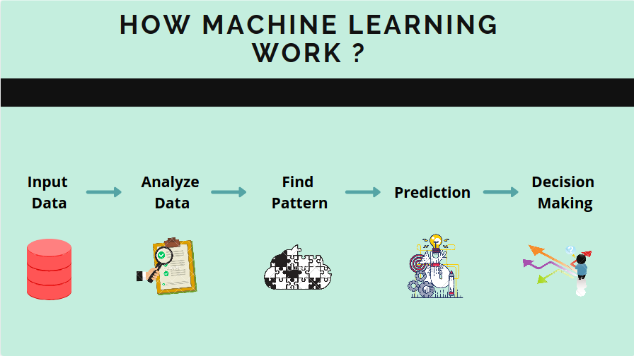

Slide 16

Types of ML

Slide 17
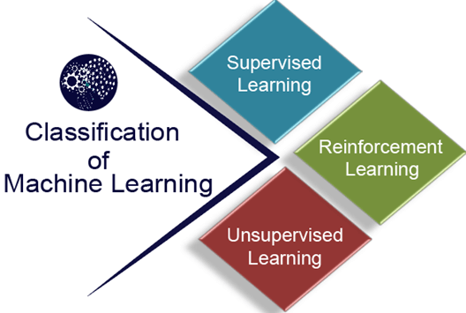

Slide 18
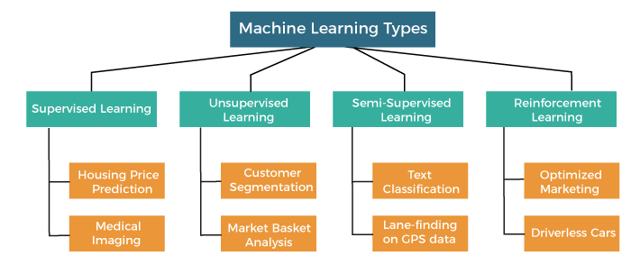

Slide 19

Supervised Learning
Supervised learning is a type of machine learning method in which we provide sample labelled data to the machine learning system in order to train it, and on that basis, it predicts the output.
The system creates a model using labeled data to understand the datasets and learn about each data, once the training and processing are done then we test the model by providing a sample data to check whether it is predicting the exact output or not.
Classification
Regression

Slide 20
The main goal of the supervised learning technique is to map the input variable(x) with the output variable(y).
Some popular classification algorithms are given below:
Random Forest Algorithm
Decision Tree Algorithm
Logistic Regression Algorithm
Support Vector Machine Algorithm

Slide 21
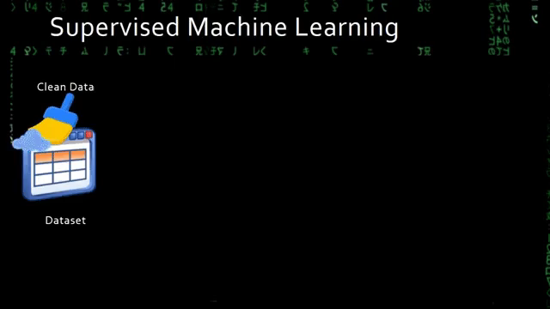

Slide 22
Unsupervised Learning
The training is provided to the machine with the set of data that has not been labelled, classified, or categorized, and the algorithm needs to act on that data without any supervision. The goal of unsupervised learning is to restructure the input data into new features or a group of objects with similar patterns.
It can be further classifieds into two categories of algorithms:
Clustering
Association

Slide 23
The main aim of the unsupervised learning algorithm is to group or categories the unsorted dataset according to the similarities, patterns, and differences. Machines are instructed to find the hidden patterns from the input dataset.
Categories of Unsupervised Machine Learning
Unsupervised Learning can be further classified into two types, which are given below:
Clustering
Association

Slide 24
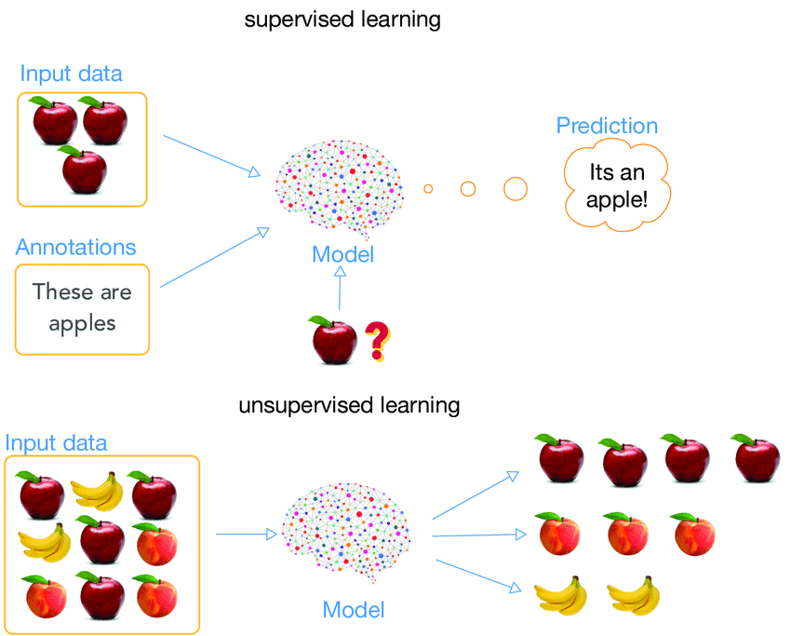

Slide 25
Semi-Supervised Learning
Semi-Supervised learning is a type of Machine Learning algorithm that lies between Supervised and Unsupervised machine learning.
Although Semi-supervised learning is the middle ground between supervised and unsupervised learning and operates on the data that consists of a few labels, it mostly consists of unlabeled data
The main aim of semi-supervised learning is to effectively use all the available data, rather than only labelled data like in supervised learning.

Slide 26
Reinforcement Learning
Reinforcement learning works on a feedback-based process, in which an AI agent (A software component) automatically explore its surrounding by hitting & trail, taking action, learning from experiences, and improving its performance. Agent gets rewarded for each good action and get punished for each bad action; hence the goal of reinforcement learning agent is to maximize the rewards.
In reinforcement learning, there is no labelled data like supervised learning, and agents learn from their experiences only.
The reinforcement learning process is similar to a human being; for example, a child learns various things by experiences in his day-to-day life
Used in Game theory, Operation Research, Information theory, multi-agent systems.

Slide 27
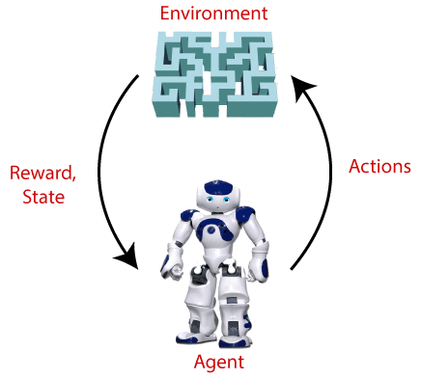

Slide 28
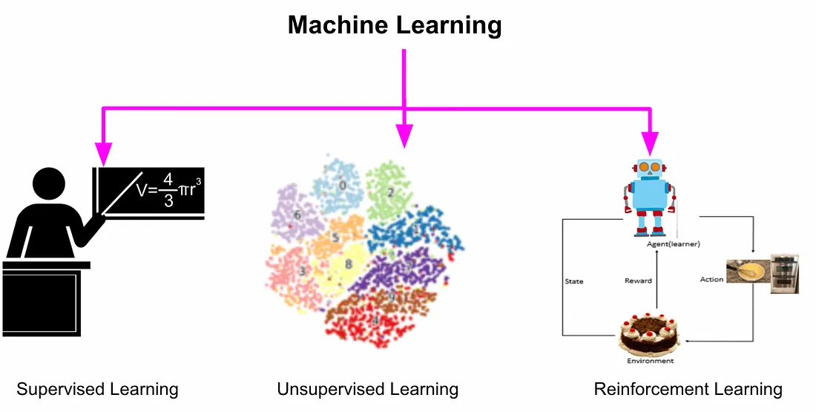

Slide 29
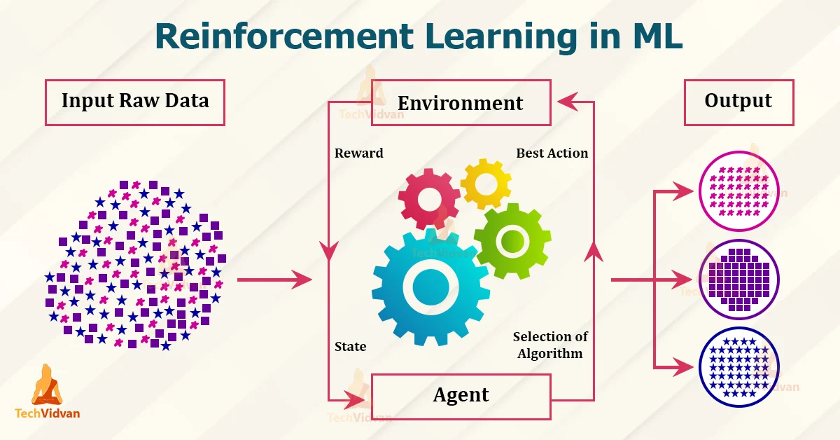

Slide 30
Machine learning algorithm
Linear regression
Logistic regression
Decision tree
SVM algorithm
Navie Bayes algorithm
KNN algorithm
K-means
Random forest algorithm

Slide 31


